Slide 1

Federated Hospital Comparer: A new end-to-end data aggregation approach for comparing hospital performance without sharing patient-level data
Department of Biostatistics, Epidemiology, and Informatics
Presenter: Jiayi (Jessie) Tong, Ph.D. Candidate
2023 ENAR
March 20, 2023
Notes:
Hello, everyone. Thank you for taking time to attend this progress meeting. Haven’t seen you for a long time and hope everyone had a xxxx thanksgiving!

Slide 2
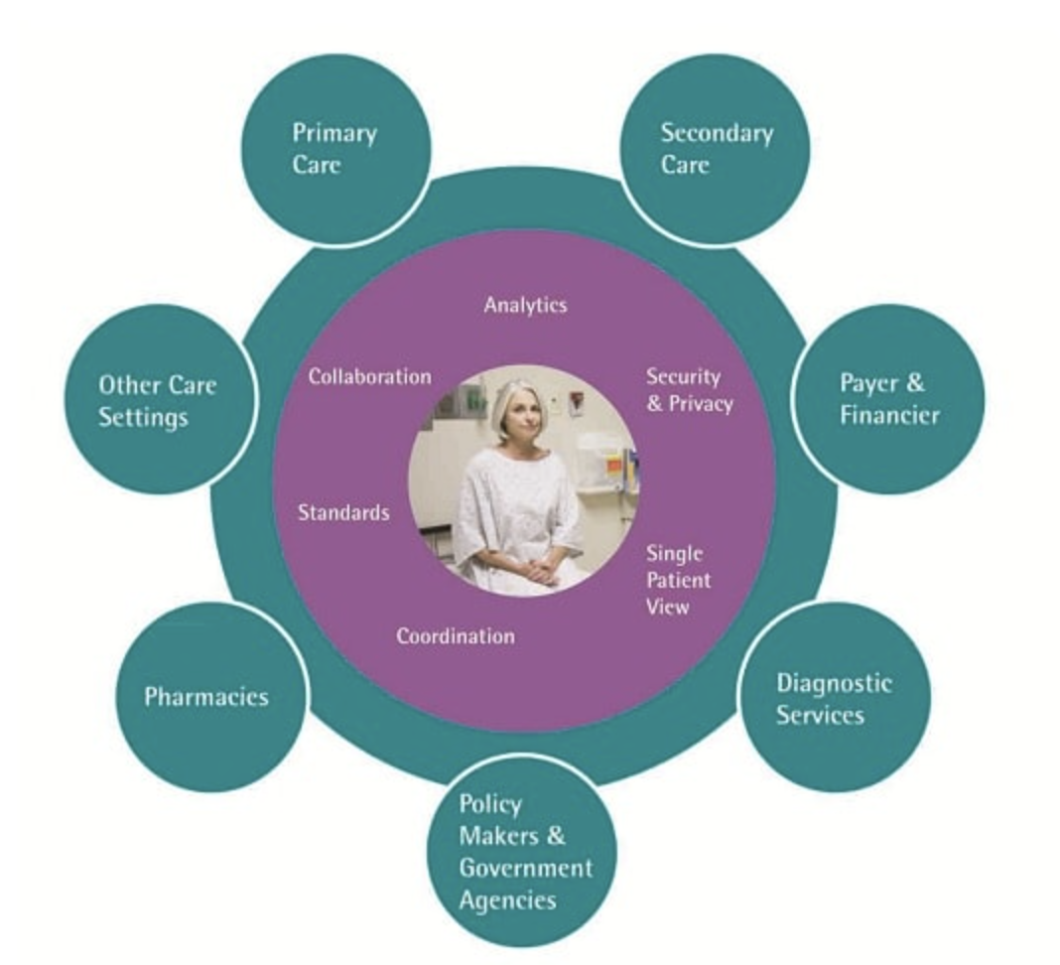
Hospital profiling
“involves a comparison of a health care provider’s structure, processes of care, or outcomes” – Normand and Shahian 2007
Images from internet
Notes:
although these process measures are straightforward and relatively easy to define, their relationship to actual health outcome measures (e.g., 30-day mortality rate, cured rate, etc) is often difficult to quantify.
More importantly, the “case-mix” situation – different health care provides are treating sets of patients.
Some hospitals are treating patients in worse conditions than the others. “case-mix” situation.

Slide 3
Hospital profiling
“involves a comparison of a health care provider’s structure, processes of care, or outcomes” – Normand and Shahian 2007
Goal:
compare the quality of care between hospitals via structural measures
E.g., nursing ratios, presence of residency programs, availability of advanced technology, volume
Images from internet
Notes:
although these process measures are straightforward and relatively easy to define, their relationship to actual health outcome measures (e.g., 30-day mortality rate, cured rate, etc) is often difficult to quantify.
More importantly, the “case-mix” situation – different health care provides are treating sets of patients.
Some hospitals are treating patients in worse conditions than the others. “case-mix” situation.

Slide 4
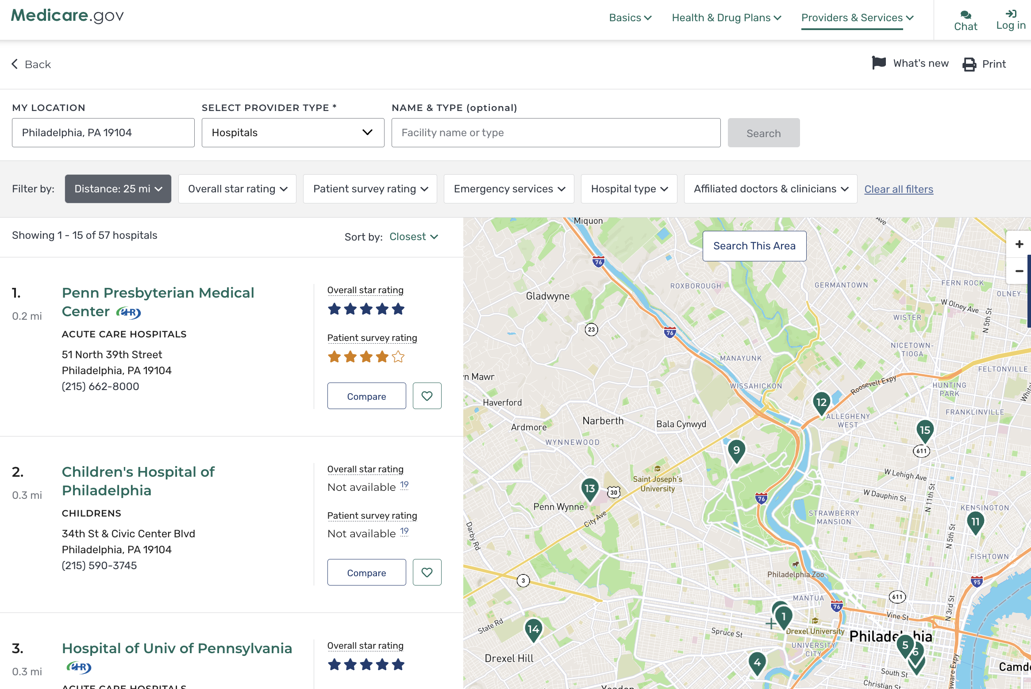
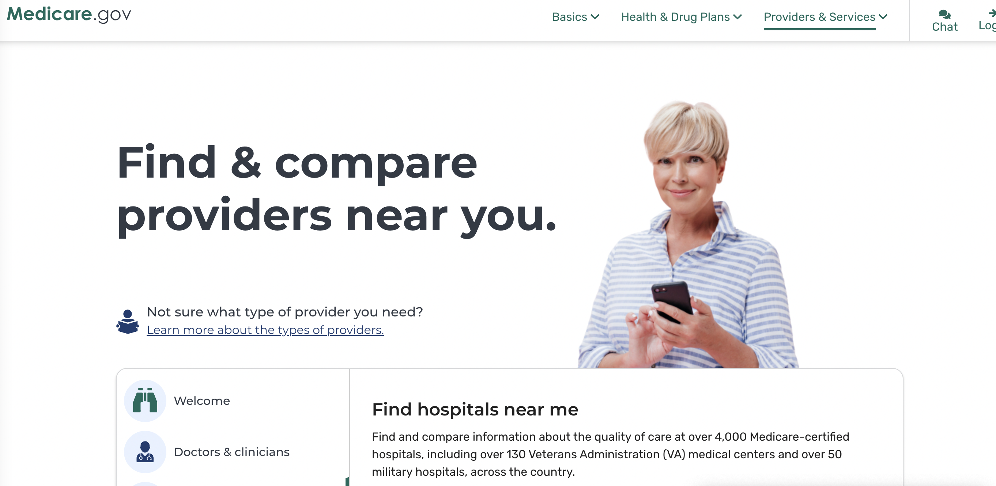
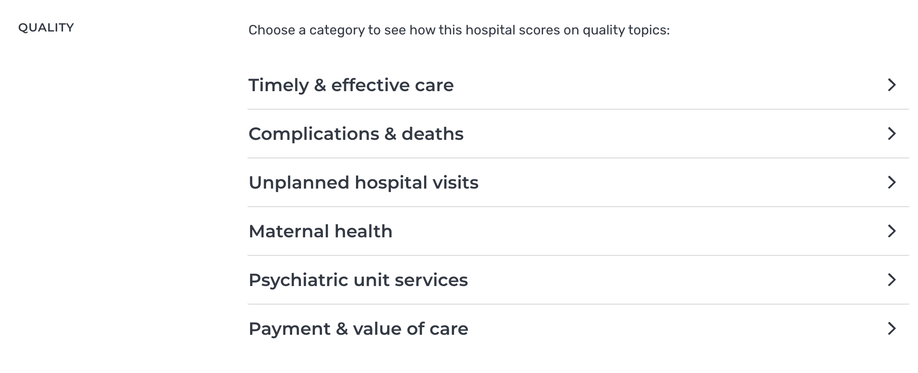

Slide 5
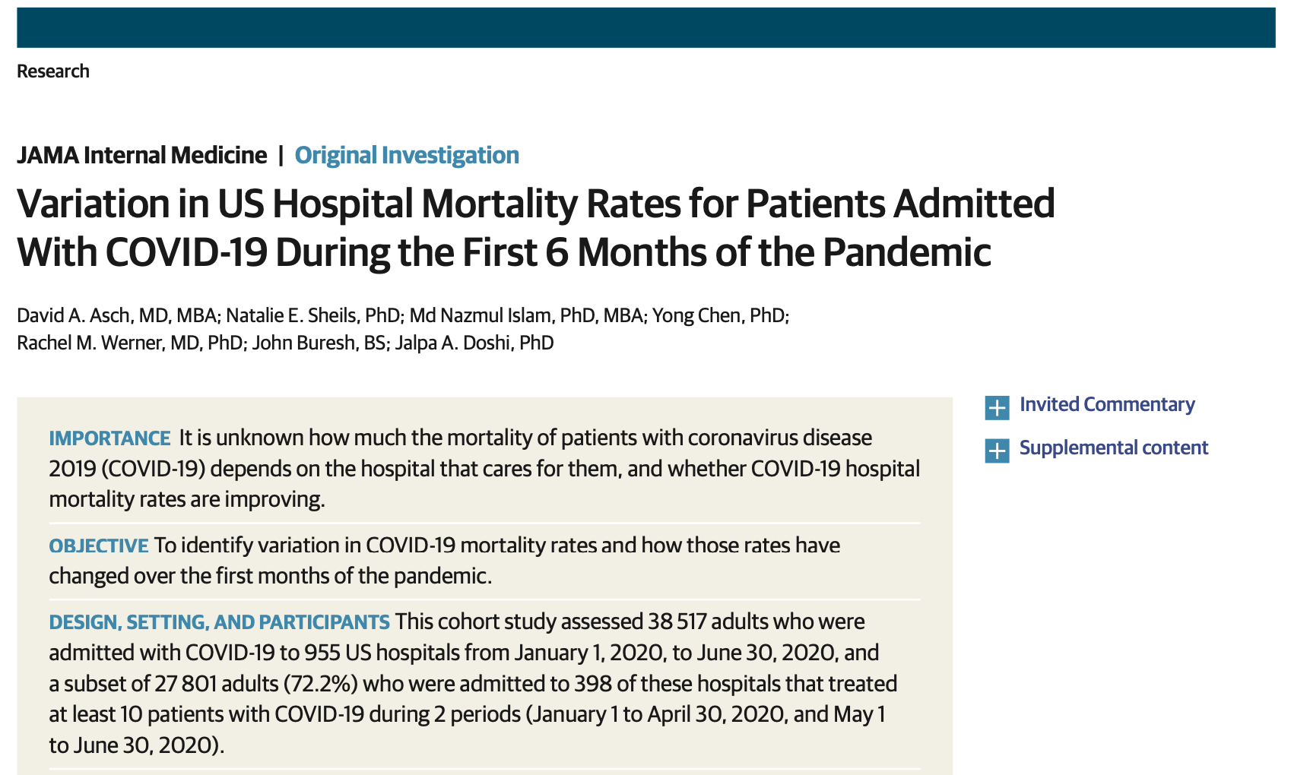
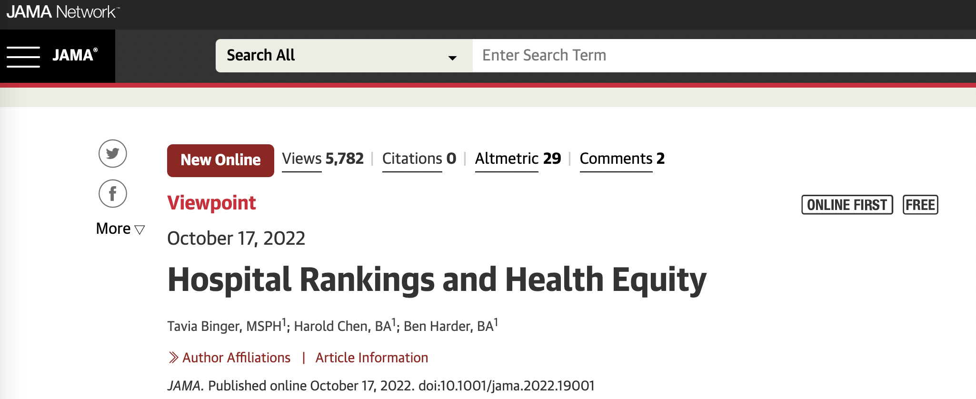

Slide 6


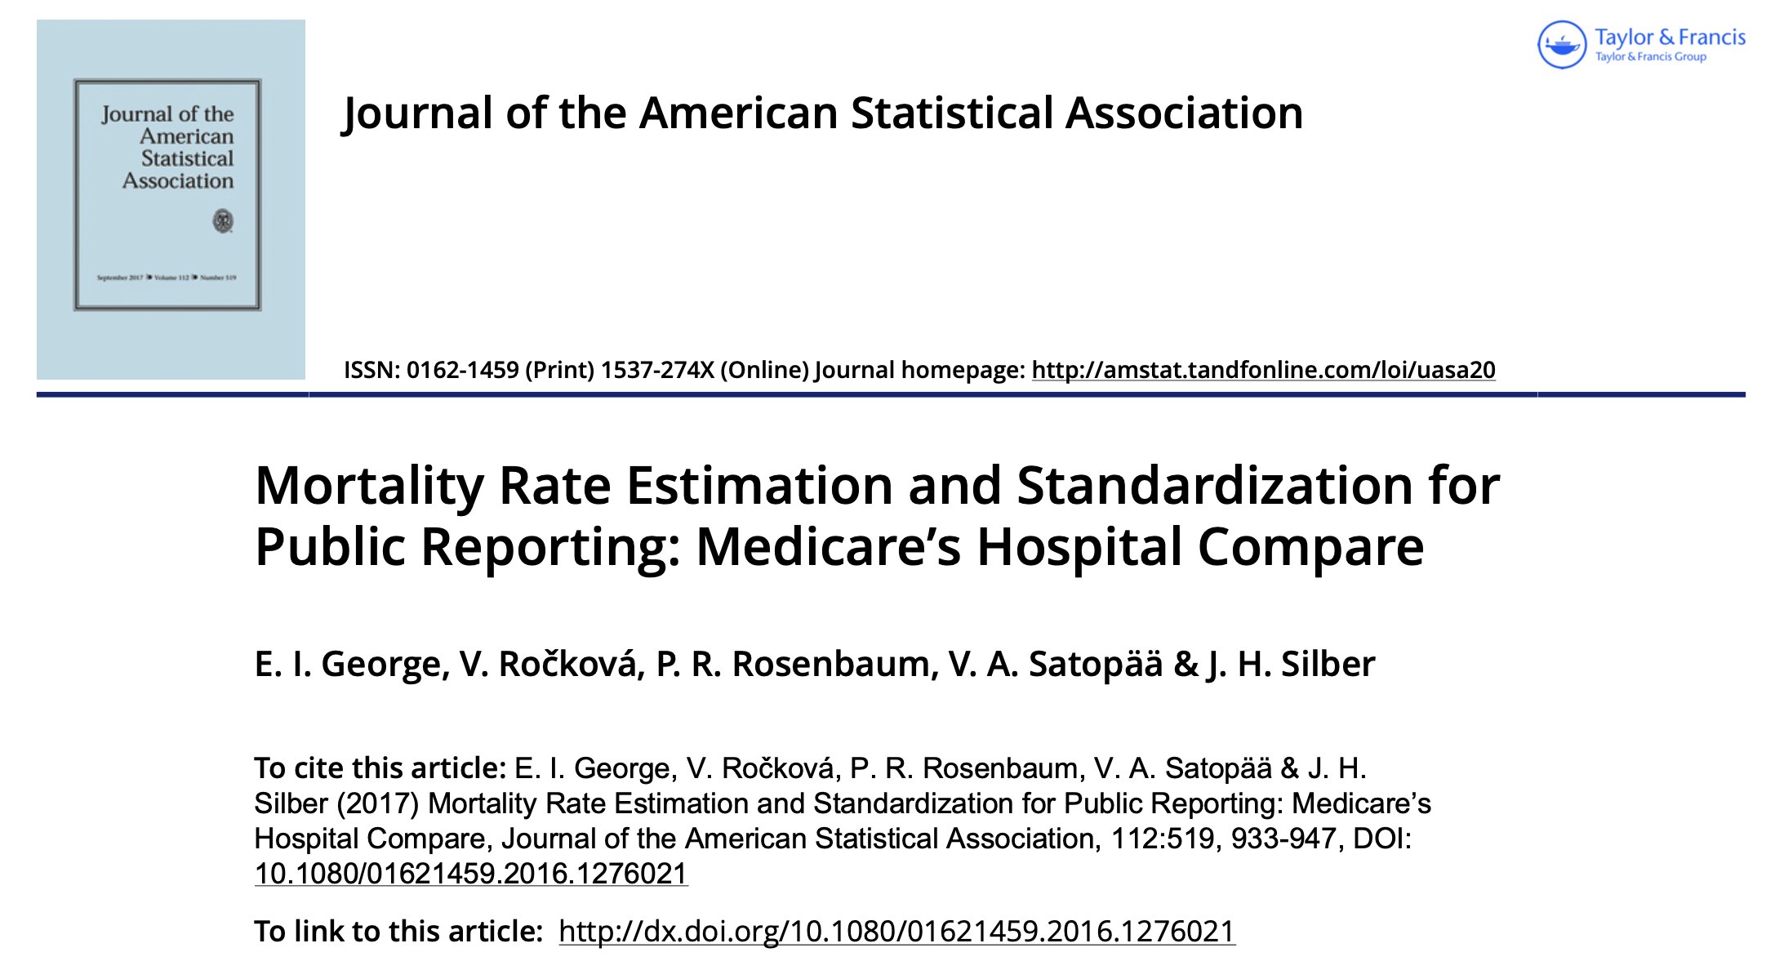

A Solution (taking mortality as an example)
Challenge
“case-mix” situation
evaluate the “risk-standardized” mortality rate by counterfactually treating all patients at a given hospital

Slide 7









Slide 8
Counterfactual

Slide 9
Counterfactual

Slide 10
Counterfactual

Slide 11
Another challenge
If a hospital want to participate the ranking, but cannot share their patient-level data

Slide 12

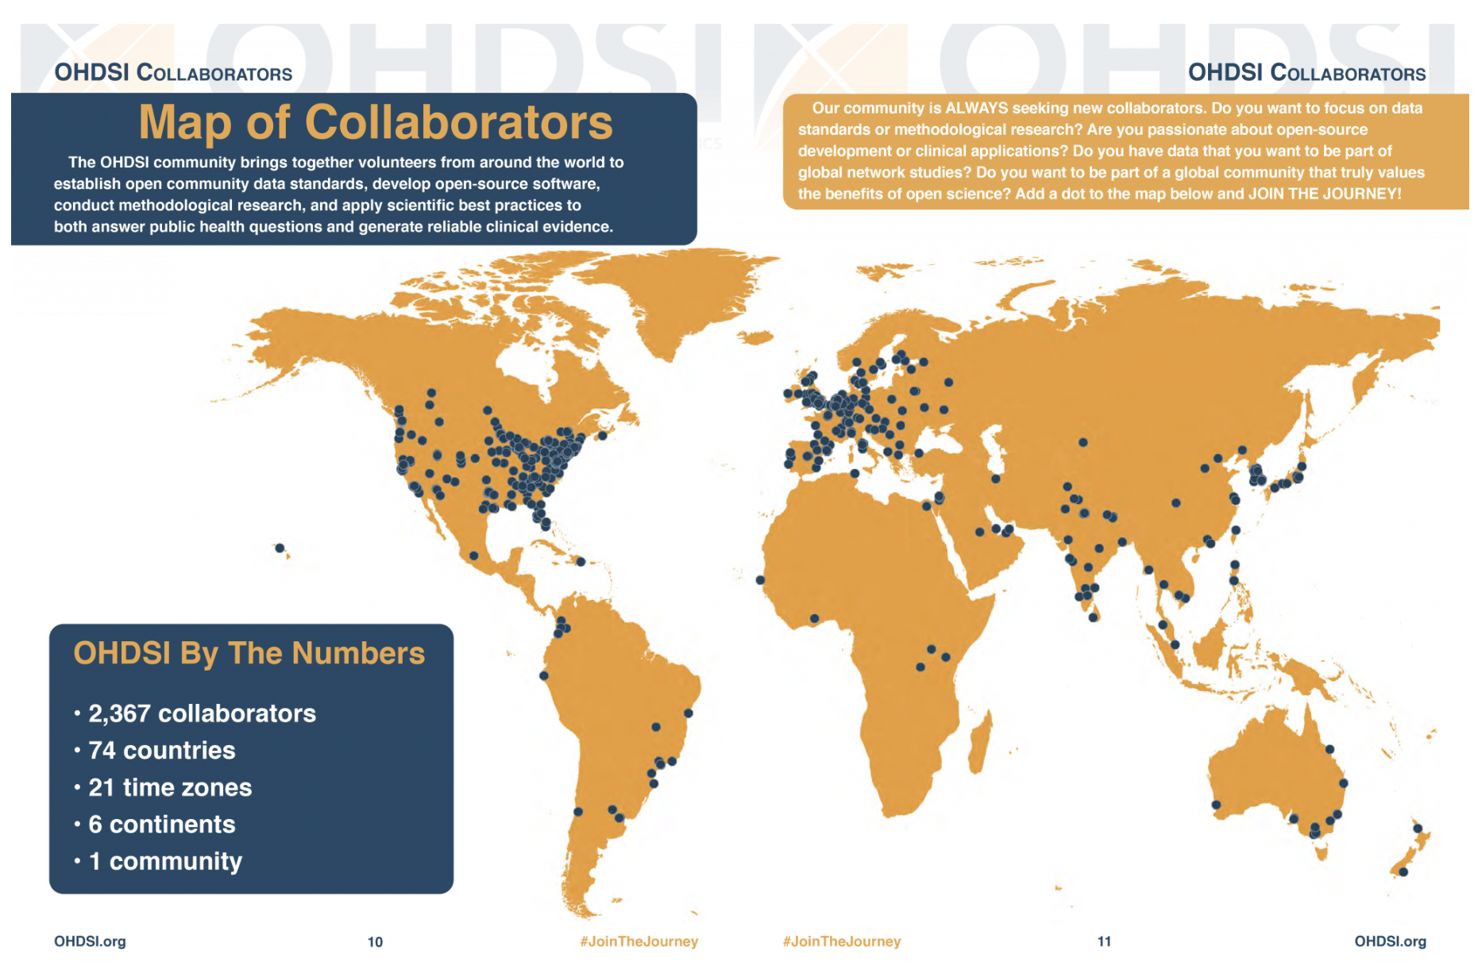

Slide 13

Conventional
Proposed
Hospital-specific
effect
Hospital-specific
effect
=

Slide 14
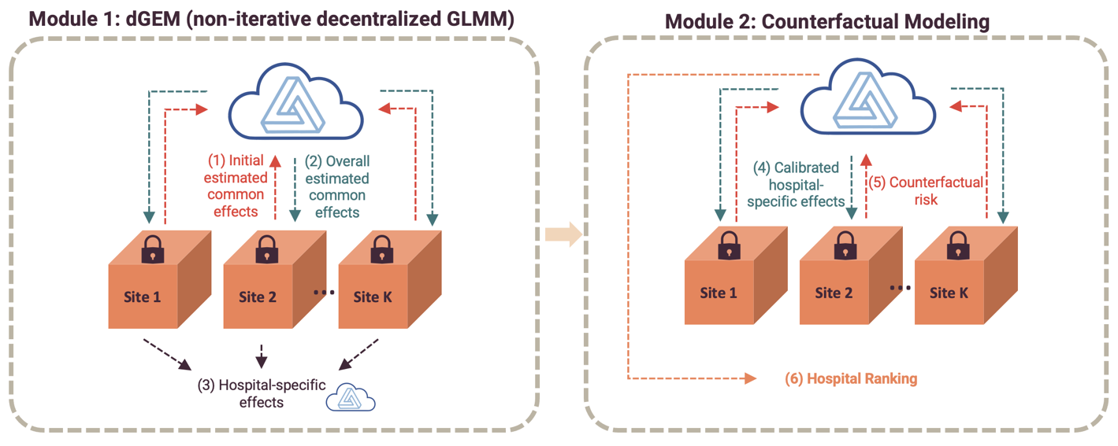

Another challenge
If a hospital want to participate the ranking, but cannot share their patient-level data
A Solution
Federated Hospital Comparer
No need to transfer patient-level data
Only transfer the hospital-specific effects
GLMM: considered as the gold standard method by Health Quality Forum

Slide 15
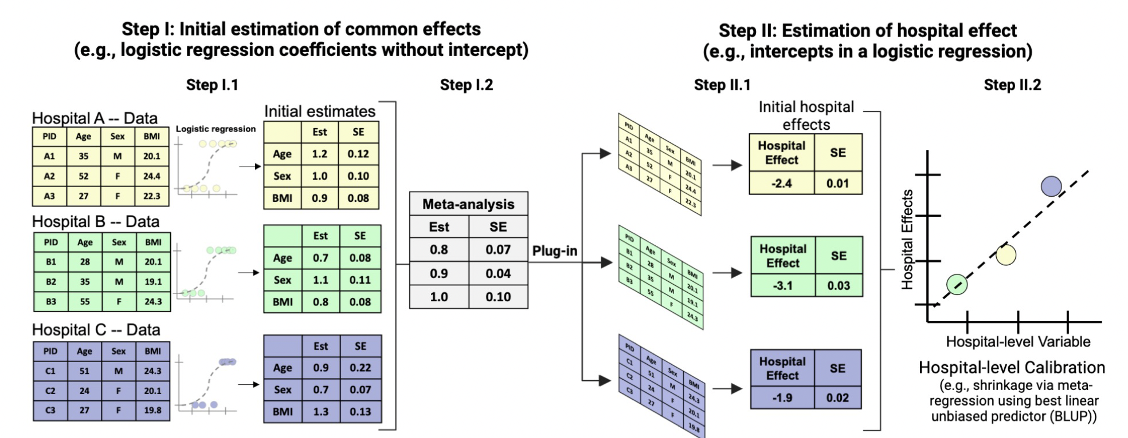
Conducting decentralized GLMM (dGEM) based on aggregated data
Y ~ hospital effect + common effect * variables
Y ~ hospital effect + common effect * variables

Slide 16
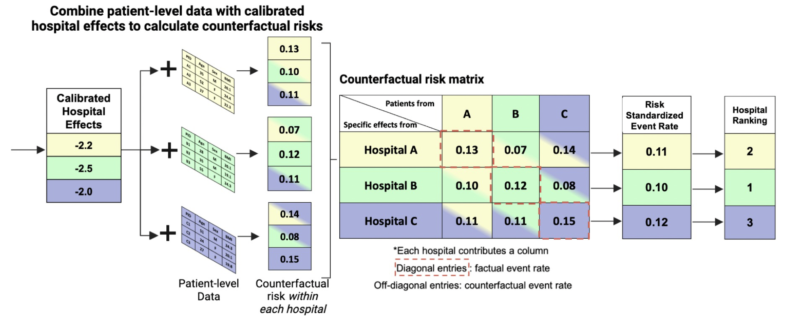
Using results from decentralized GLMM (dGEM) to perform event rates calculation and hospital profiling
Step III:

Slide 17
Use case 1
National kidney transplant registry data
Centralized data from 149 sites
collected from the U.S. Organ Procurement and Transplantation Network (OPTN)
Cohort
40,938 adults deceased donor recipients who experienced a kidney transplant between January 1, 2008 and December 31, 2012
Outcome
Binary
Outcome = 1 if died or had graft failure within one year after receiving a kidney transplant
Variables
Patient-level
Recipient: age, gender, race, Body Mass Index (BMI), diabetes status, cold ischemia time, and total End Stage Renal Disease (ESRD) time at transplant
Donor: age, gender, race, BMI, hypertension status,
Hospital-level
number of visits/patients of transplant in each center

Slide 18
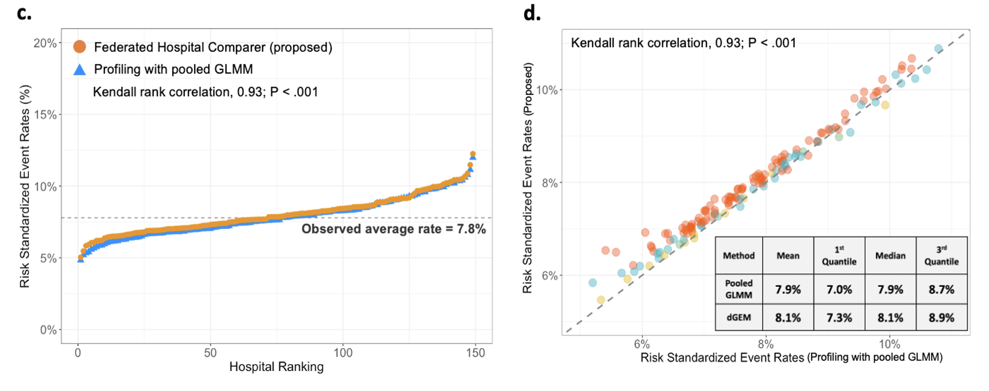
Implementation using centralized kidney data

Slide 19
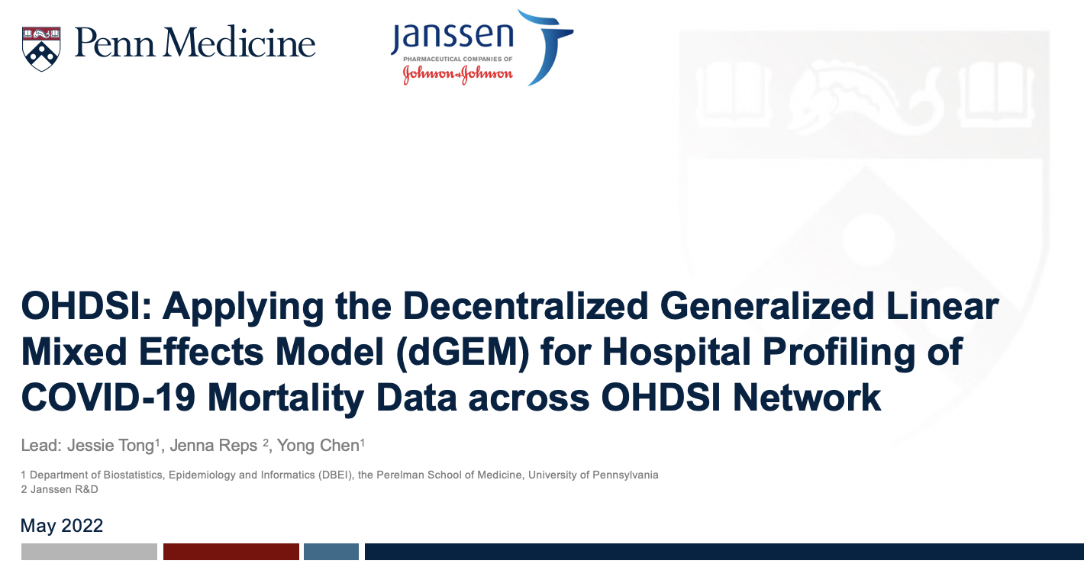
Use case 2
OHDSI network

Slide 20

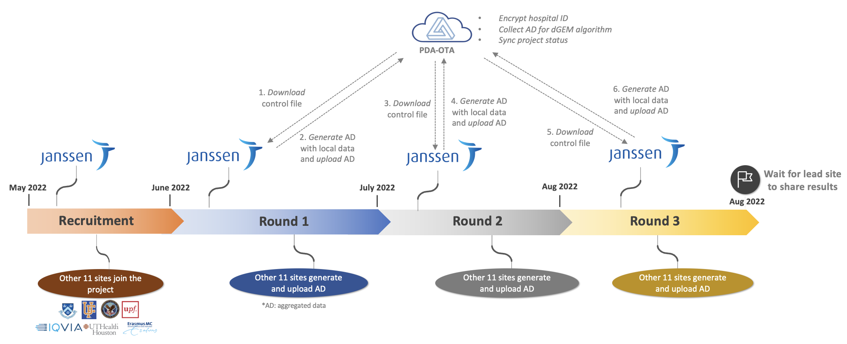
Implementation of dGEM within OHDSI network

Slide 21
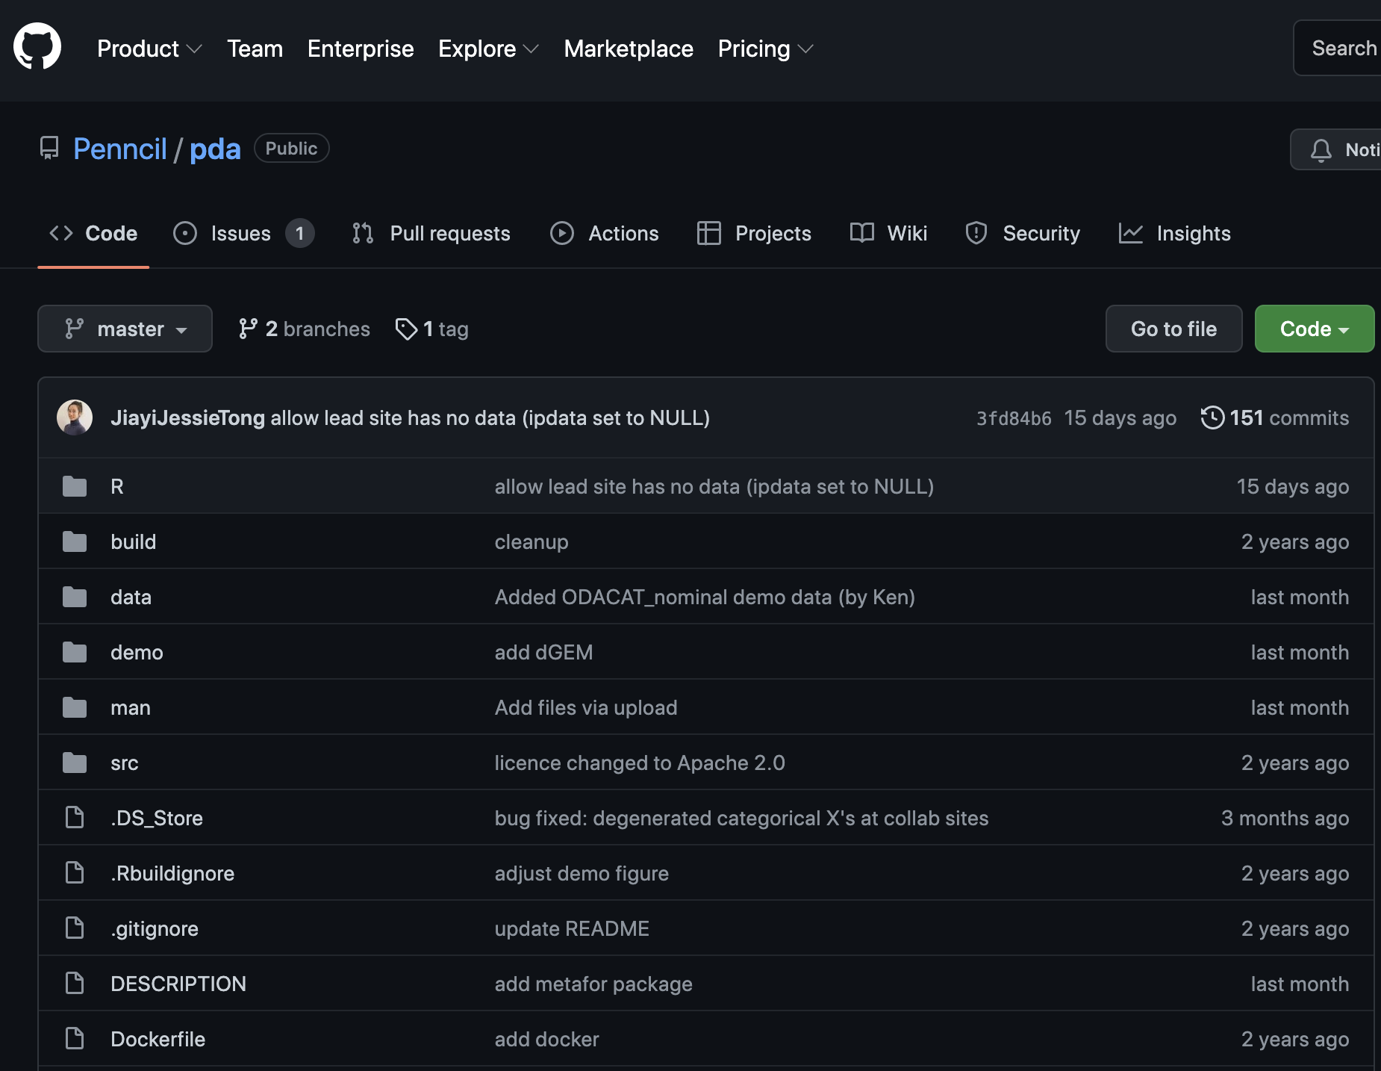
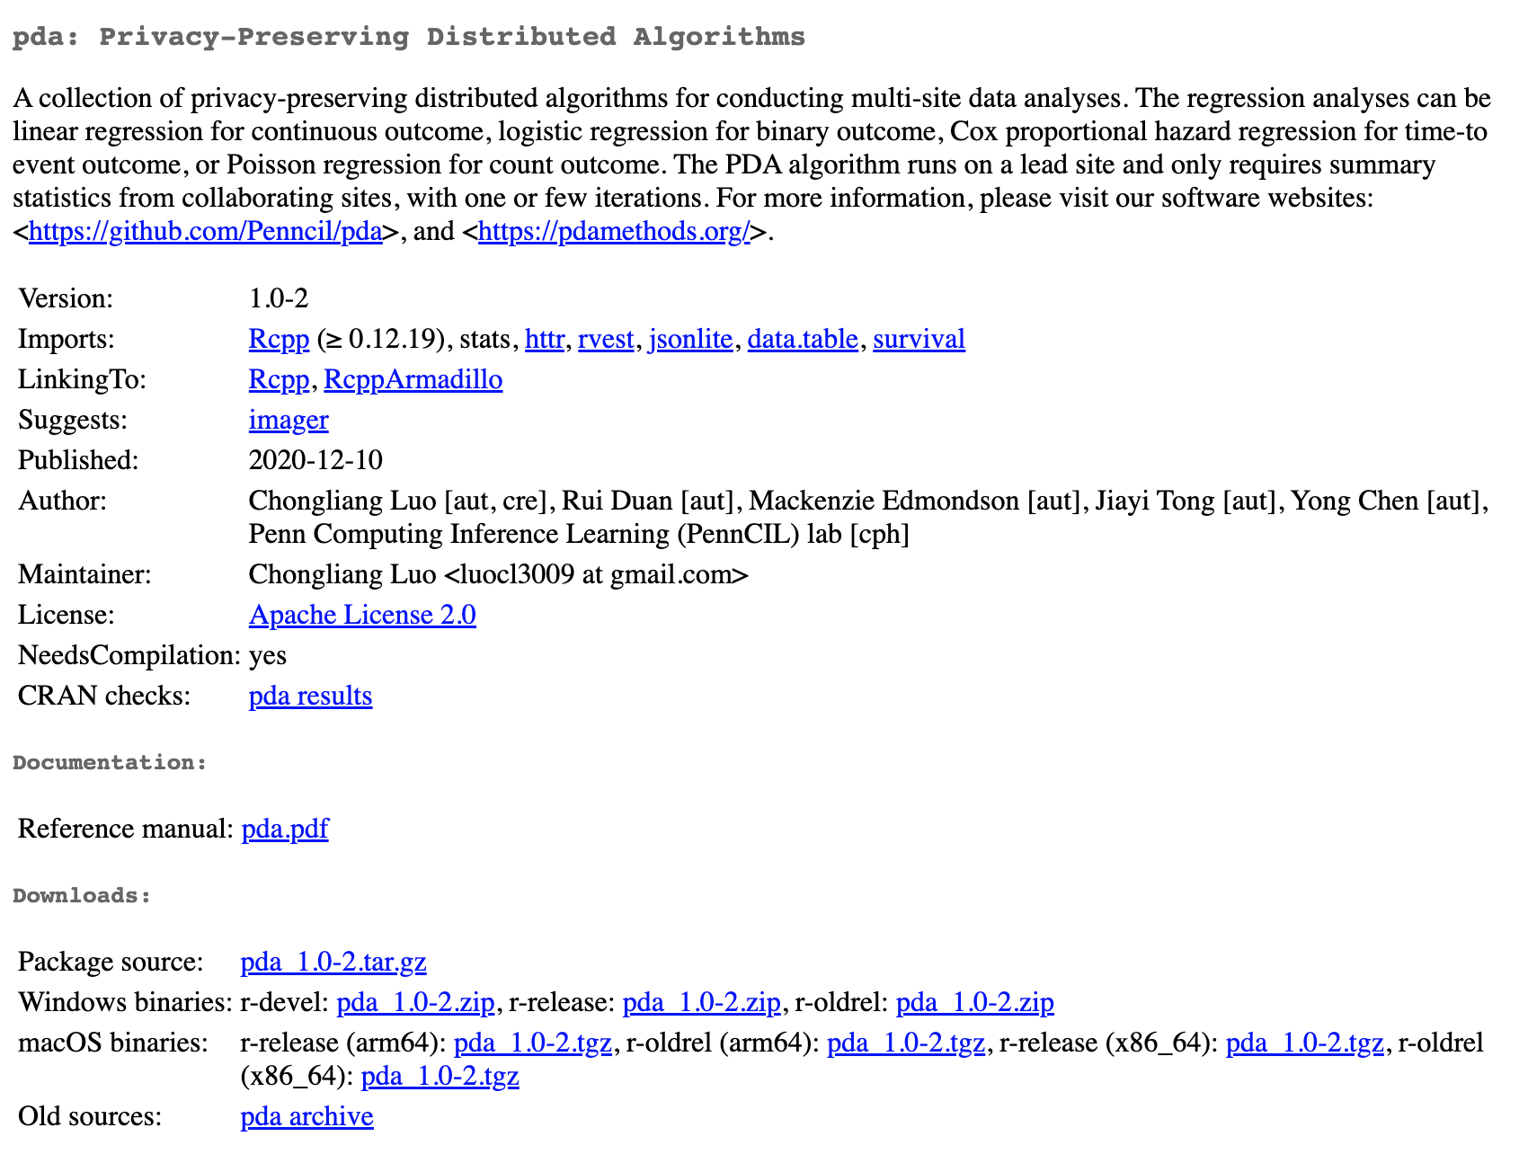
Implementation – dGEM in pda R package

Slide 22

Implementation – PDA-OTA

Slide 23
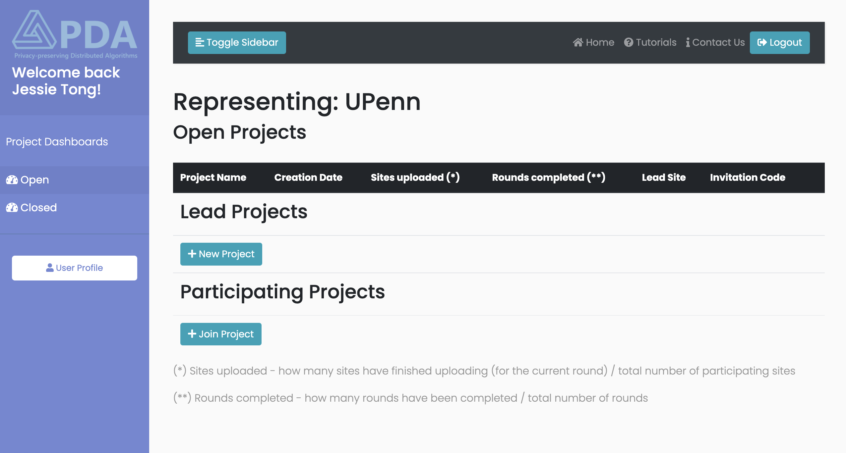
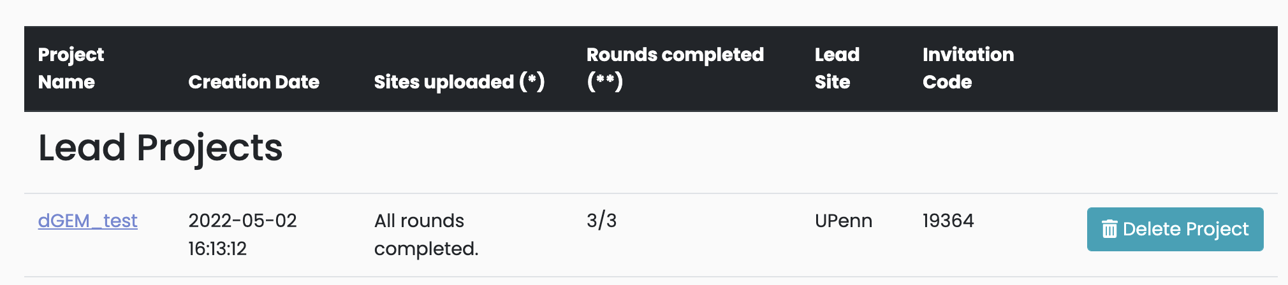



Slide 24
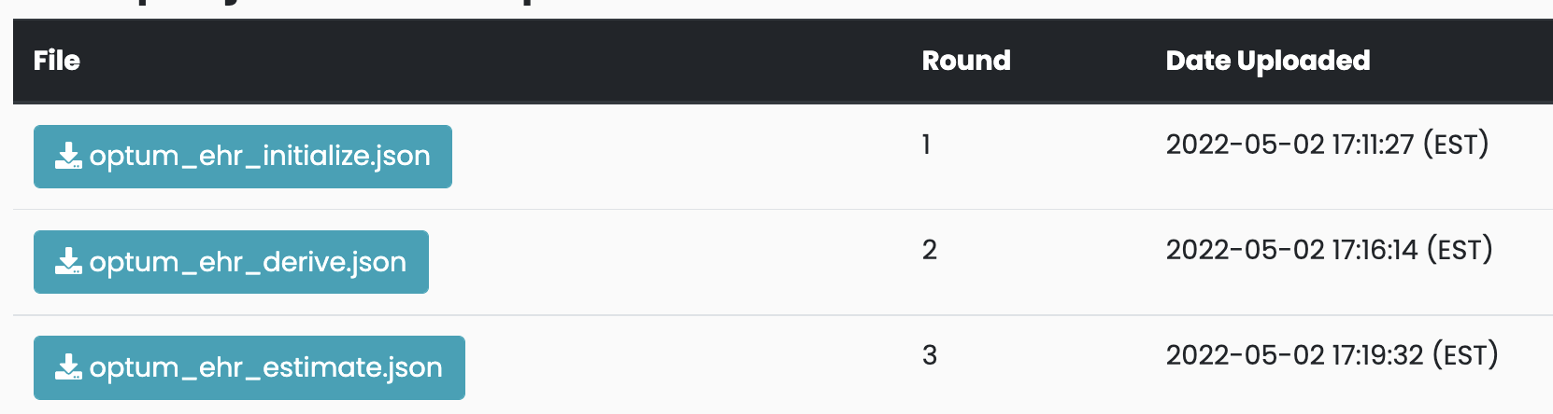
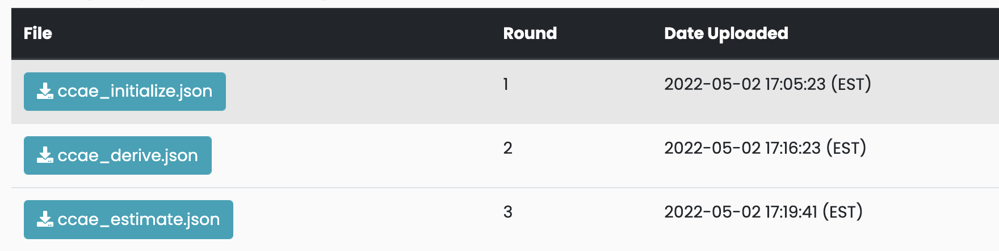


Slide 25
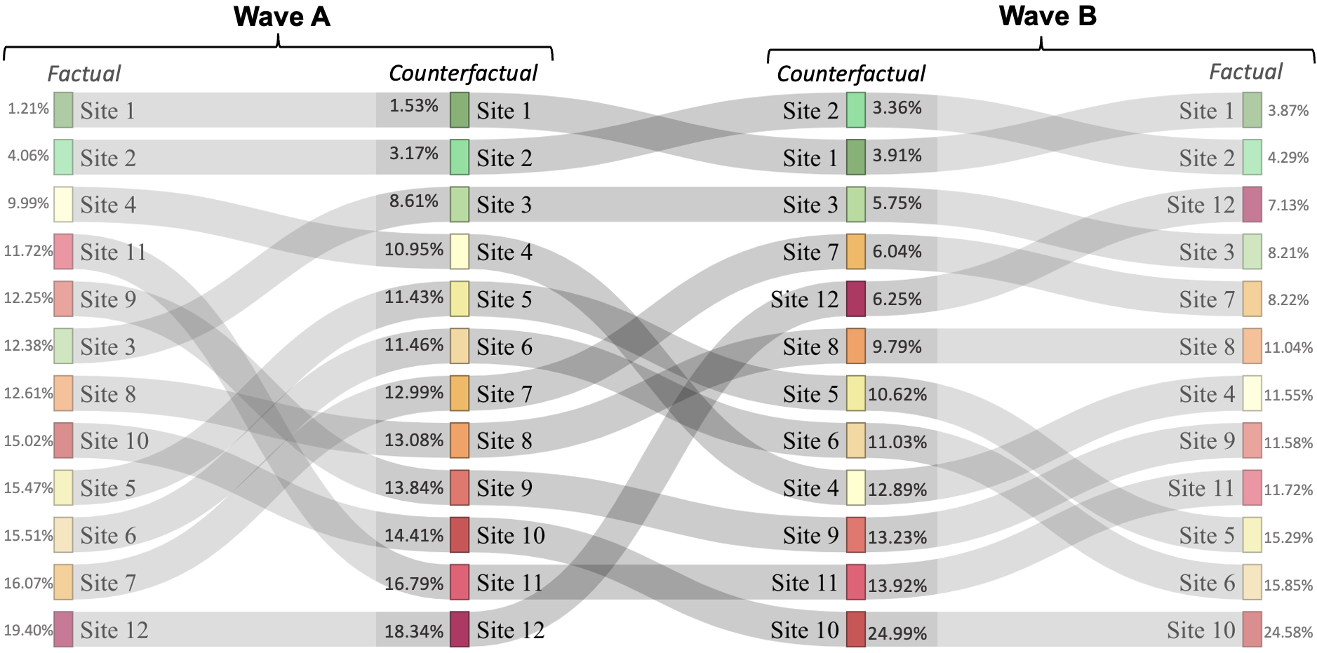
Results – Ranking across two waves

Slide 26
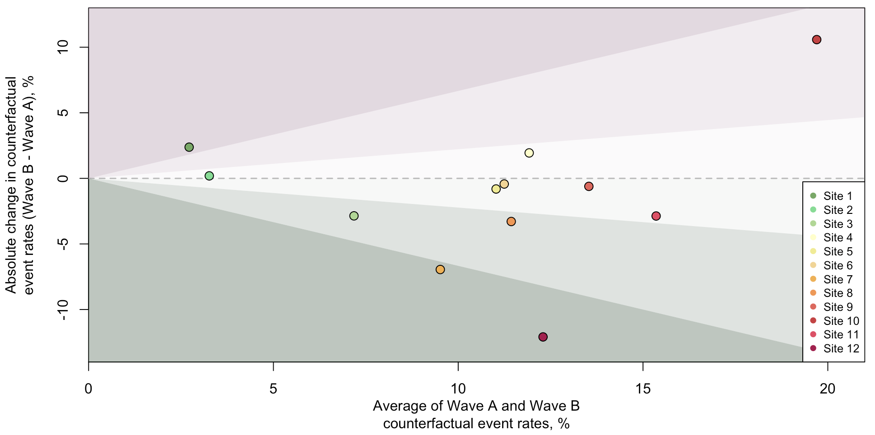
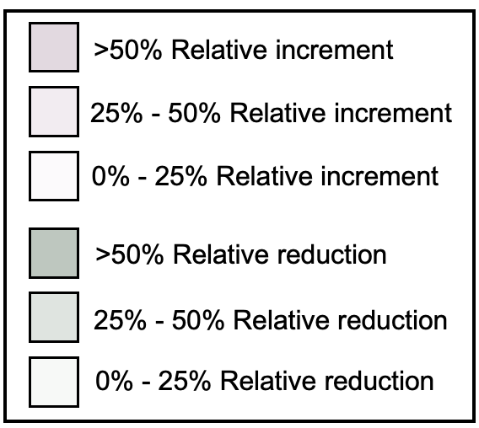
Results – Bland–Altman plot on two-wave change in counterfactual event rates

Slide 27
Summary
Federated Hospital Comparer
Solve the case-mix situation
Only require aggregated data
Validation through two use cases
Use case 1: obtain comparable results as the gold standard method
Use case 2: feasible under real-world decentralized setting
Future works
Other types of outcomes
Racial disparities

Slide 28
Acknowledgement
Jenna M. Reps
Chongliang Luo
Martijn J. Schuemie
Patrick B. Ryan
Haitao Chu
Jiang Bian
Elizabeth A Shenkman
Yiwei Lu
Juan Manuel Ramirez-Anguita
Milou T. Brand
Zhaoyi Chen
Scott L. DuVall
James Yang
Yujia Zhou
Elizabeth A. Stuart
Harlan M. Krumholz
Hua Xu
Rachel M. Werner
David A. Asch*
Yong Chen*
Thomas Falconer
Alex Mayer Fuentes
Kevin He
Jing Li
Michael E. Matheny
Miguel A. Mayer
Bhavnisha Patel
Marc A. Suchard
Di Wang
Ross D. Williams
Katherine Simon
Sarah Seager

Slide 29


